Slide 1



Implement address map using A* search algorithm
Shawan Das - 19101020
PAGE
1/7

Slide 2


A* IMPLEMENTATION ON ROAD MAP
"Content"
Problem Statement
Graph
Tree Diagram
Technical Report
Source Code
Conclusion
PAGE
2/7

Slide 3


Introduction
Admissible of a Node
0 < = h(B) < = h*(B) where h(B) - Heuristic value if Node-B h*(B) - optimal path cost from Node-B to goal node-Goal
Consistency
V(S,G): 0 <= h(S) - h(G) <= cost (S,G) where, h(S/G) - heuristic value of Node S/G
PAGE
3/7

Slide 4
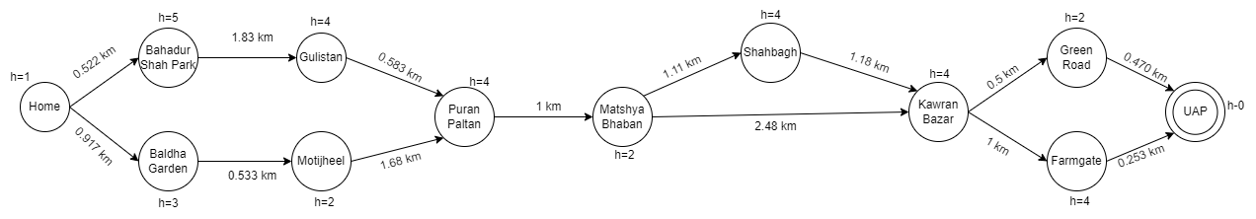
Graph
PAGE
4/7

Slide 5
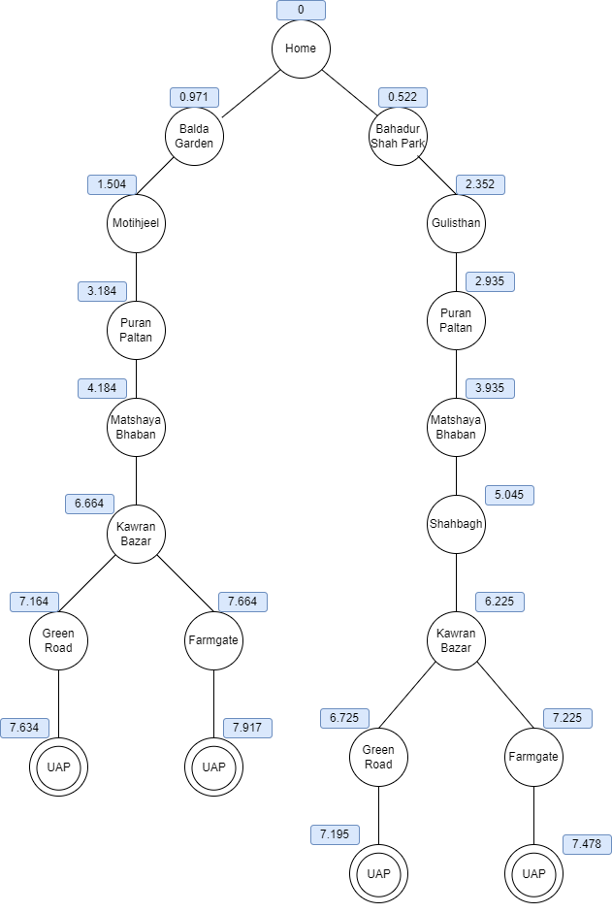
Search Tree
PAGE
5/7

Slide 6
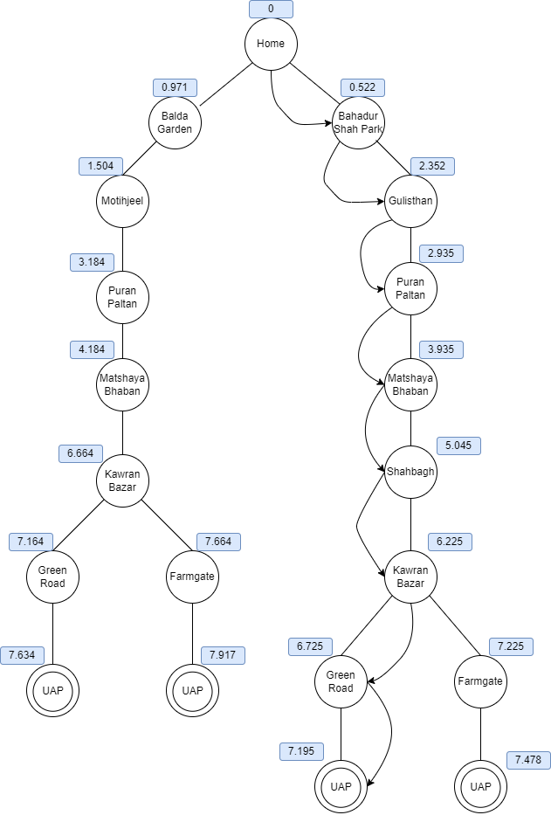
Shortest Path
PAGE
6/7

Slide 7
The End
We're ready to answer your questions.
PAGE
7/7

